Slide 1
The Writing on the Wall: Another Warning Against Pride
Daniel 5:1-9

Slide 2
The Setting for the Passage
King Nebuchadnezzar died in 562 BC.
His son, Nabonidus, assumed power after him.
Belshazzar was the son of Nabonidus, and he co-ruled the kingdom with him.
Therefore, when Daniel says that Nebuchadnezzar was the father of Belshazzar that means he was an ancestor or grandfather. Both are used in the same manner.

Slide 3
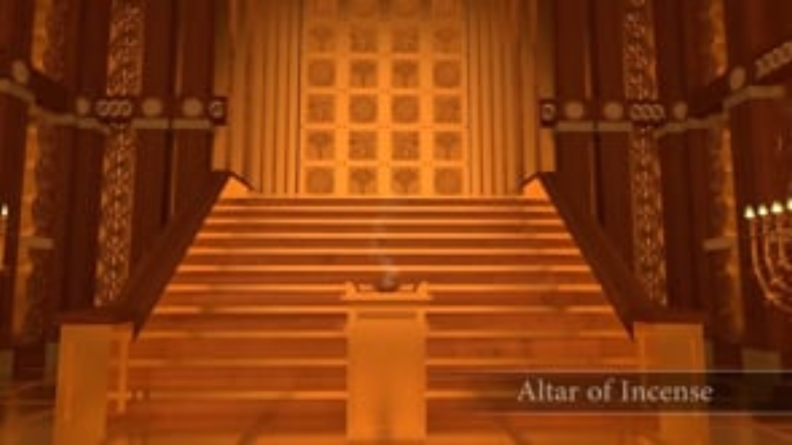

Slide 4
The King Mocks the Holy Vessels (vv. 1-4)
King Belshazzar is having a wild party.
They were drinking wine and had most likely started to become drunk. He begins to lose his judgment.
God has designed all things to be used for a certain purpose. He does not tolerate that they be misused.
For example, mankind does not have the authority to bend or twist Scripture to meet their own desires.

Slide 5
God Gets the King’s Attention (vv.5-6)
The hand begins writing on the wall in the room.
God is showing His anger at the king for misusing the holy vessels from the temple.
This terrifies the king, and he is dismayed.
Sometimes God must take measures to get the attention of those who mock Him.
When mankind chooses to ignore God and refuse His laws then He will allow them to go their own way.

Slide 6
The King Looks for the Answer in the Wrong Place (vv. 7-9)
This king, just like his grandfather, sought answers with the wisemen. But they could not help him again!
Mankind chooses listen to other sources of wisdom rather than God because those sources will tell them what they want to hear. (2 Timothy 4:1-5)
Also, if they choose to accept God’s wisdom, they will be held accountable to follow it. They reject out of fear.

Slide 7
Application
Our application today: God’s sovereignty and holiness demand our respect, and any attempt to mock or undermine His authority results in serious consequences.
Rather than relying on our own wisdom we must give God the honor and respect He deserves.
Our pride will cause us to fall. May we be content to accept God’s wisdom and let Him lead the way!

